Slide 1

8279 Keyboard/ Display Interface
(UNIT-4)
(SUB: Microprocessor and Interfaces)
PREPARED BY:
ER. MOHIT MISHRA
ASSOCIATE PROFESSOR
COMPUTER SCIENCE DEPARTMENT

Slide 2
TOPIC COVERED
The BASICS OF 8279
8279 SIGNALS
PIN DETAILS OF 8279
8279 PIN DISCRIPTION
BLOCK DIAGRAM OF 8279
BLOCK DIAGRAM 8279
MODES OF 8279

Slide 3
BASICS OF8279
The Intel 8279 is a Keyboard/Display Controller is specially developed for interfacing keyboard and display devices for the Intel 8085, 8086 Microprocessors.
The device is well suited for driving seven or eighteen segment display units and for interfacing matrix key boards.

Slide 4
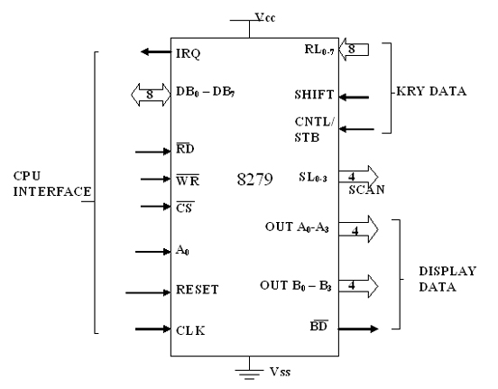
8279 signals

Slide 5
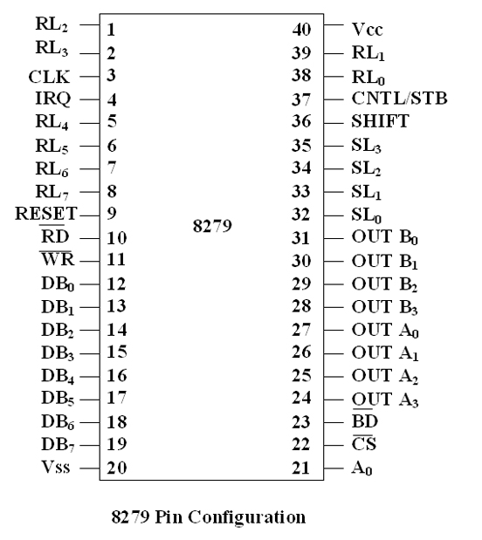
PIN DETAIL 8279

Slide 6
8279 PIN DISCRIPTION
DB₀-DB₇ : These are bidirectional data bus lines. The data and command words to and from the CPU are transferred on these lines.
RD, WR ( Input / Output ) READ/WRITE :These input pins enable the data buffers to receive or send data over the data bus.
A0(Address lines) : A high on this line indicates the transfer of a command or status information. A low on this line indicates the transfer of data. This is used to select one of the internal registers of 8279.

Slide 7
8279 PIN DISCRIPTION
CS : Chip Select – A low on this line enables 8279 for normal read or write operations. Other wise, this pin should remain high.
RESET : This pin is used to reset 8279. A high on this line reset 8279. After resetting 8279, its in sixteen 8-bit display, left entry encoded scan, 2-key lock out mode. The clock prescaler is set to 31.
CLK : This is a clock input used to generate internal timing required by 8279.

Slide 8
8279 PIN DISCRIPTION
IRQ : This interrupt output lines goes high when there is a data in the FIFO sensor RAM. The interrupt lines goes low with each FIFO RAM read operation but if the FIFO RAM further contains any key-code entry to be read by the CPU, this pin again goes high to generate an interrupt to the CPU.
Vss, Vcc : These are the ground and power supply lines for the circuit.
SL0-SL3-Scan Lines : These lines are used to scan the key board matrix and display digits. These lines can be programmed as encoded or decoded, using the mode control register.

Slide 9
8279 PIN DISCRIPTION
RL0 - RL7 - Return Lines : These are the input lines which are connected to one terminal of keys, while the other terminal of the keys are connected to the decoded scan lines. These are normally high, but pulled low when a key is pressed.
SHIFT : The status of the shift input lines is stored along with each key code in FIFO, in scanned keyboard mode. It is pulled up internally to keep it high, till it is pulled low with a key closure.
CNTL/STB- CONTROL/STROBED I/P Mode : In keyboard mode, this lines is used as a control input and stored in FIFO on a key closure. The line is a strobed lines that enters the data into FIFO RAM, in strobed input mode. It has an interrupt pull up. The lines is pulled down with a key closer.

Slide 10
8279 PIN DISCRIPTION
OUT A0 – OUT A3 and OUT B0 – OUT B3 : These are the output ports for two 16*4 or 16*8 internal display refresh registers. The data from these lines is synchronized with the scan lines to scan the display and keyboard. The two 4-bit ports may also as one 8-bit port.
BD – Blank Display : This output pin is used to blank the display during digit switching or by a blanking closure.

Slide 11
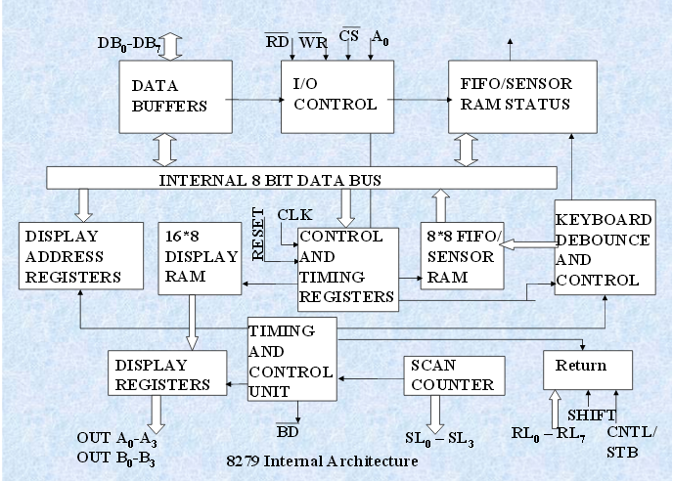
Block Diagram of 8279

Slide 12
Block Diagram of 8279
It consists 4 main section.
CPU interface and control section.
Scan section
Keyboard Section
Display section.
CPU INTERFACE AND CONTROL SECTION:
It consists of
Data buffers
I/O control
Control and timing registers.
Timing and control logic.

Slide 13
Block Diagram of 8279
Data Buffers:
8-bit bidirectional buffer.
Used to connect the internal data bus and external data bus.
I/O control:
I/O control section uses the A0,CS,RD and WR signals to controls the data flow.
The data flow is enabled by CS=0otherwise it is the high impedance state.
A0=0 means the data is transferred.
A0=1 means status or command word is transferred.

Slide 14
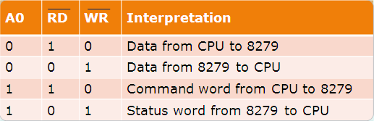
Block Diagram of 8279
I/O control signals

Slide 15
Block Diagram of 8279
TIMING AND CONTROL REGISTERS:
Store the keyboard and display modes and others operating condition programmed by the CPU.
The modes are programmed by sending proper command A0=1.
TIMING AND CONTROL:
It consist timing counter chain.
First counter is divided by N prescalar that can be programmed to give an internal frequency of 100 KHz.

Slide 16
8279 Modes
The modes of operation of 8279 are as follows :
1. Input (Keyboard) modes.
2. Output (Display) modes.
Input ( Keyboard ) Modes :
8279 provides three input modes. These modes are as follows
1. Scanned Keyboard Mode: This mode allows a key matrix to be interfaced using either encoded or decoded scans. In encoded scan, an 8*8 keyboard or in decoded scan, a 4*8 keyboard can be interfaced. The code of key pressed with SHIFT and CONTROL status is stored into
the FIFO RAM

Slide 17
8279 Modes
2. Scanned Sensor Matrix : In this mode, a sensor array can be interfaced with 8279 using either encoded or decoded scans. With encoded scan 8*8 sensor matrix or with decoded scan 4*8 sensor matrix can be interfaced.
The sensor codes are stored in the CPU addressable sensor RAM.
3 Strobed input: In this mode, if the control lines goes low, the data on return lines, is stored in the FIFO byte by byte

Slide 18
8279 Modes
Output (Display) Modes: 8279 provides two output modes for selecting the display options. These are discussed briefly.
1. Display Scan: In this mode 8279 provides 8 or 16 character multiplexed displays those can be organized as dual 4- bit or single 8-bit display units.
2. Display Entry: ( right entry or left entry mode ) 8279 allows options for data entry on the displays. The display data is entered for display either from the right side or from the left side

Slide 19
8279 Modes
Scanned Keyboard mode with 2 Key Lockout: In this mode of operation, when a key is pressed, a debounce logic comes into operation.
During the next two scans, other keys are checked for closure and if no other key is pressed the first pressed key is identified.
The key code of the identified key is entered into the FIFO with SHIFT and CNTL status, provided the FIFO is not full, i.e. it has at least one byte free.
If the FIFO does not have any free byte, naturally the key data will not be entered and the error flag is set.

Slide 20
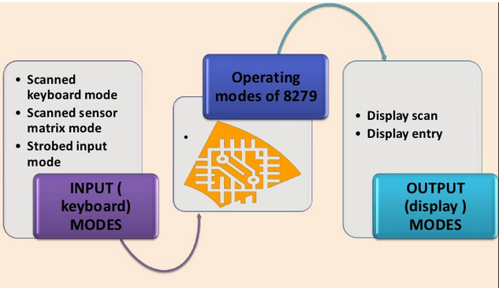
8279 Modes

Slide 21
The BASICS OF 8255 PPI
PPI = Programmable Peripheral Interface
The 8255 allows the microprocessor to communicate with the outside world through three programmable 8-bit wide I/O ports
The PC uses a few 8255 (in the chip set) to control the keyboard, speaker, and parallel port
The 8255 PPI is available in DIP or surface mount forms
Also implemented as functions within modern interface chip sets

Slide 23
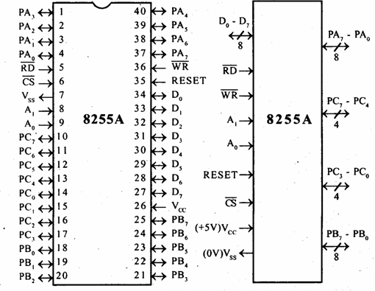
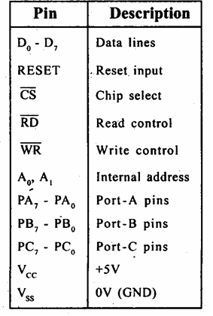
PIN DETAILS

Slide 24
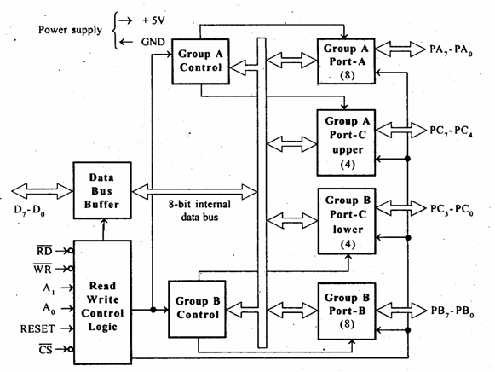
INTERNAL BLOCK DIAGRAM OF 8255

Slide 25
BLOCK DIAGRAM FEATURES
Data bus buffer:
This is a tri state bidirectional buffer used to interface the 8255 to system data bus. Data is transmitted or received by the buffer on execution of input or output instruction by the CPU.
• Control word and status information are also transferred
through this unit.

Slide 26
READ/WRITE CONTROL LOGIC
This unit accepts control signals ( RD, WR ) and also inputs from address bus and issues commands to individual group of control blocks
( Group A, Group B).It has the following pins.
a) CS – Chipselect : A low on this PIN enables the
communication between CPU and 8255.
b) RD (Read) – A low on this pin enables the CPU to read
the data in the ports or the status word through data bus buffer.
c) WR ( Write ) : A low on this pin, the CPU can write
data on to the ports or on to the control register through
the data bus buffer.
d) RESET: A high on this pin clears the control register
and all ports are set to the input mode
e) A0 and A1 ( Address pins ): These pins in conjunction
with RD and WR pins control the selection of one of the
3 ports.

Slide 27
I/O PORT ASSIGNMENTS
Group A is Port A and upper ½ of Port C (PC7-PC4).
Group B is Port B and lower ½ of Port C (PC3-PC0).
A1 | A0 | Function
0 | 0 | Port A
0 | 1 | Port B
1 | 0 | Port C
1 | 1 | Command Register
Writing into this register
programs the various ports to operate in
various modes and be used
as either inputs or outputs

Slide 28
I/O PORT ADDRESS
Data bus
D[7:0]
PA[7:0]
A0
8085
A1
PB[7:0]
RD
Control port
WR
PC[7:0]
RESET
A7
CS
A6
A5
A1 A0
Port
A4
A3
0 0
0 1
0
1 1
PA
PB
PC
Control
A2
IO/M

Slide 29
DIFFERENT MODES OF 8255
8255 has two different modes:
Bit Set – Reset mode
I/O modes
I/O mode further divided into three modes
MODE 0
MODE 1
MODE 2

Slide 30
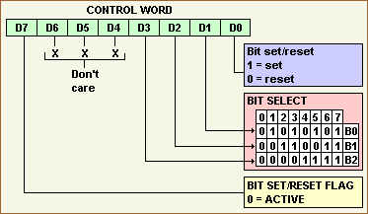
CONTROL WORD FORMAT FOR BIT SET RESET MODE

Slide 31
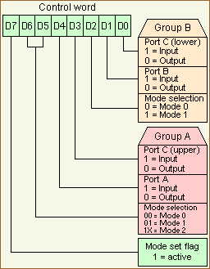
CONTROL WORD FORMAT FOR I/O MODE

Slide 32
I/O MODE
Mode 0: Simple Input or Output
Ports A, B, and C can be individually programmed as input or output ports
Port C is divided into two 4-bit ports which are independent from each other
Mode 1: Input /Output Control Signals
Ports A and B are programmed as input or output ports
Port C is used for handshaking
Mode 2: Bidirectional Data transfer
Port A is programmed to be bi-directional
Port C is for handshaking
Port B can be either input or output in mode 0 or mode 1

